Slide 1
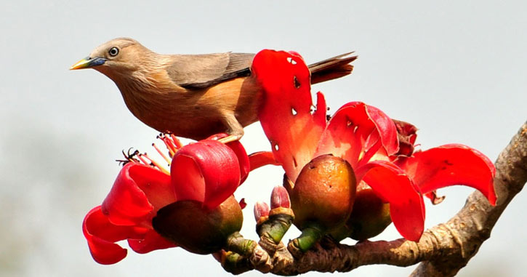
Welcome to all students.

Slide 2
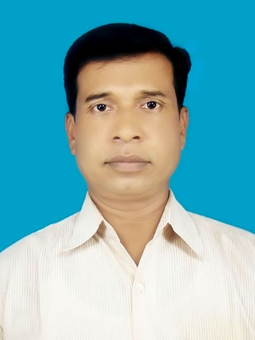
Prepared by
Subject:English.
Class:Four.
Time:50 Minutese.
.Date:20/02/2018.
Jahedur Rahaman
Assistant teacher
Sagoria Govt Primary School.
Hatiya, Noakhali.

Slide 3
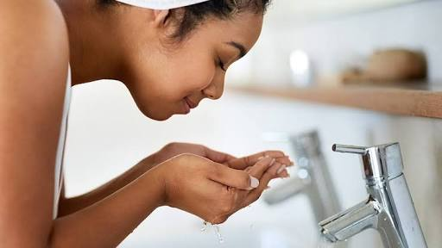
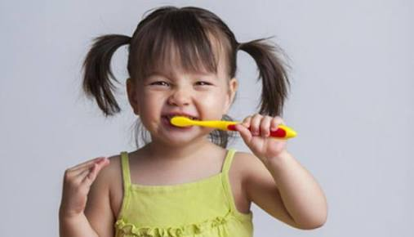
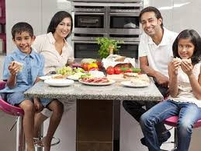
Look at the picture and say what is our todays lesson.

Slide 4
Todays Lesson
Mita”s day
Lessons-1-2
Page no-28

Slide 5
Learning outcomes
Student will be able
(a)to enjoy and understand simple stories.
(b)Give answer some questions about Mita.
(c)Similar words and make sentences by using words.

Slide 6
Presentation
Time-30 minutes

Slide 7
What do you see in the picture and say.
Mita gets up at six o’clock.

Slide 8
What do you see in the picture and say.
She washes her face.

Slide 9
What do you see in the picture and say.
She has breakfast at seven o’clock.

Slide 10
What do you see in the picture and say.
She brushes her teeth.

Slide 11
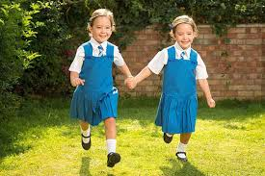
What do you see in the picture and say.
Mita goes to school at nine o.clock.

Slide 12
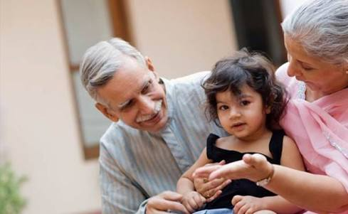
What do you see in the picture and say.
She visits her grandmother.

Slide 13
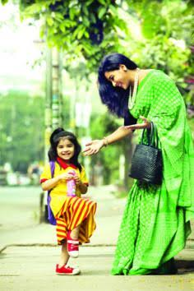
What do you see in the picture and say.
Mita returns home at five o’clock.

Slide 14
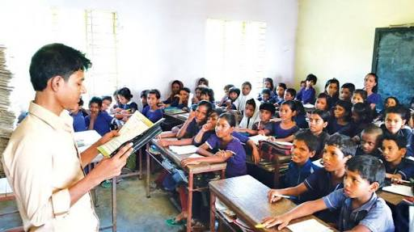
Teachers Loud reading
Time-3 minutes

Slide 15
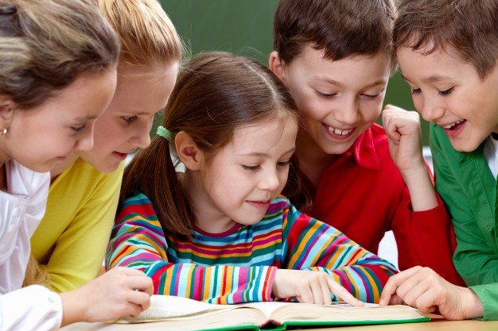
Open your book at page 28.

Slide 16
Students Silent Reading
Time-2 minutes

Slide 17
WCW
Answer the following questions.
Time-5 minutes
1.What class does Mita read in?
2.When does Mita get up from bed?
3.When does Mita has breakfast?
4.What time does Mita go to school?
5.When does Mita return home?

Slide 18
GW
Evaluation
Time-5 minutes
Complete the sentences with the time in numbers.Use a.m or p.m
1.Mita gets up at—------.
2.She has breakfast at-------.
3.She goes to school at------.
4.She visits her grandmother at---.
5.She returns home at----------------.
6am
7am
9am
3pm
5pm

Slide 19
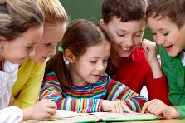
Choose the best anwer .
GW
1.What time does Mita get up?
a)At 5am
b)At 6am
c)At 7am
d)At 8am
2.What time does Mita go to school?
a)7am
b)8am
c)9am
d)10am
3,When does Mita return home?
a)4am
b)5am
c)6am
d)7am

Slide 20
Match the words of the column A with their meaning that is mentioned in the text in the column B.
IW
Column A |  | Column B
a)O`clock |  | 1.To see
b)Breakfast |  | 2.To come back
c)Visit |  | 3.According to the clock.
d)Grandmother |  | 4.Mother of father only.
e)Return |  | 5.The first meal of the day.
 |  | 6.Go away
 |  | 7.Mother of father or mother

Slide 21
Homework
Write five sentences about your yourself.

Slide 22
Goodbye to all Students

